Slide 1

Final Grade Predictor
-GradeBuddy
Machine Learning Model
By: Krishala Chhetri

Slide 2
Table of contents.
01 | Loading Phase
02 | EDA, Objective
03 | Data Preprocessing
04 | Model Training & Performance Output
05 | Visualization of
Model Performance

Slide 3


Step 1: Loading The Student Performance Data
Imported dataset from the UCI Student Performance (Math) CSV file
Utilized Pandas to read and explore the data
Understood that data includes student info such as grades, habits, etc
Considered target variable : G3 (final grade to be predicted)

Slide 4

Step 2 : Exploratory Data Analysis
Exploratory Data Analysis (EDA) is a data exploration technique to understand the various aspects of the data. We must be able to understand the relationship between variables through EDA which gives us a bigger picture of our data. It is basically used to filter the data from redundancies, helps us identify faulty points in our data. Steps are :
Understand the data
Clean the data
Analysis of Relationship between variables

Slide 5
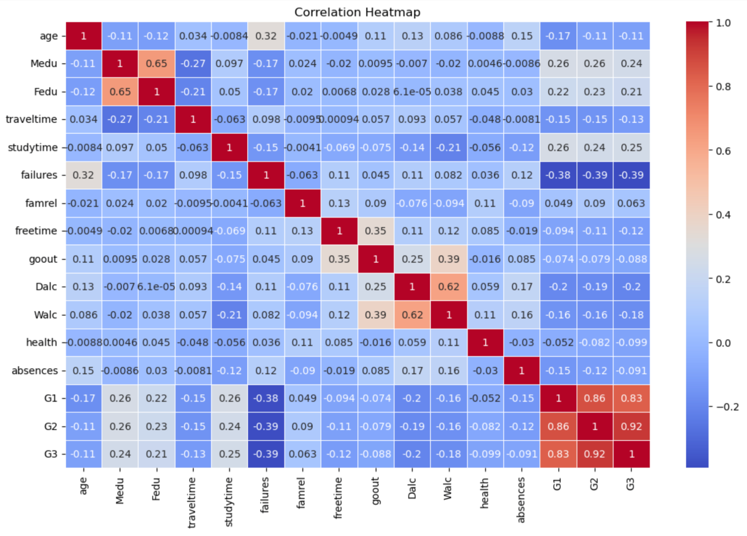
Analyzing the relationship between variables
Correlation Matrix : I decided to build a Heatmap, by utilizing sns.heatmap() function which is the Seaborn’s heatmap function to draw a colored grid of numbers which is perfect for visualizing correlations. The higher the correlation values, stronger the impact it has.
cmap='coolwarm'
This sets the color gradient:
Red for strong positive values (close to +1)
Blue for strong negative values (close to -1)
White/gray near 0 (no correlation)

Slide 6
Analysis of Heatmap
+1:Perfect Positive Relationship (⬆️⬆️)
0:No relationship at all
-1:Perfect Negative Relationship(⬆️⬇️)
Strongest Correlations :
G2 (Second Term Grade):
Strongest positive correlation with G3 (r≈ 0.92)
Students who perform well on their second term are most likely to score high in the final grade
G1(First Term Grade):
Strong positive correlation with G3 (r ≈ 0.83)
Early academic performance is a key indicator of final success

Slide 7
Analysis of Heatmap
Study time
Positive correlation to G3 (r≈ 0.25)
More study time generally improves grades
Medu and Fedu (Parent’s education background)
Positive correlation to G3 (r≈ 0.24 and r ≈ 0.21 resp.)
Parent’s education background also has some influence
Negative Correlations
Failures
Negative correlation to G3 (r≈-0.39)
More past failures are linked to lower final grades
Dalc and Walc (Weekday/Weekend Alcohol Use)
Negative correlation to G3(r≈ -0.2 and r ≈ -0.18 resp.)
Higher alcohol consumption slightly lowers the performance
Key Takeaways
-Prior Performance (G1,G2) are the strongest predictors of Final Grades
-Study Behavior (Study time, failures) also matter, but less strongly
-Lifestyle factors (goout, health) have minimal impact

Slide 8
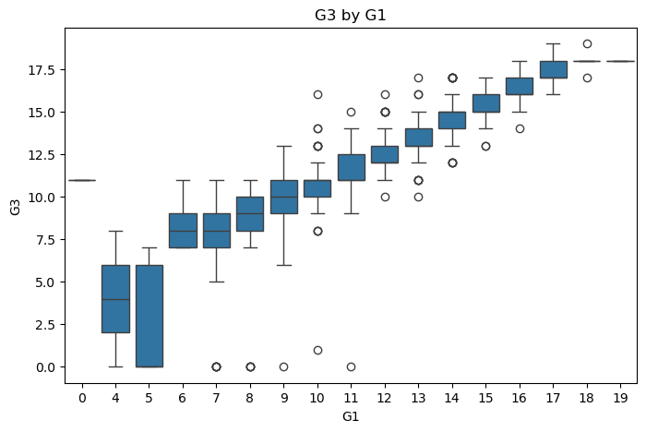
Visualization
As a part of visualization, I also created Boxplot for each variable to see clearly how it relates to the G3.
In this Box Plot :
A clear upward trend is observed
As G1 increases, the range of G3 also rises.
Students who scored high in the first term (G1>=15) also ended with high final grades.
Students with lower G1 scores have lower and more varied G3 outcomes.
Box Plot : G3 with respect to G1

Slide 9
Step 2 : Data Preprocessing
Did you know the importance of data Preprocessing ?
Our dataset has strings like “F”, “M”, “yes”, “no” or “GP” and “MS’ and Machine Learning Models can’t understand them
So, preprocessing converts all of that into numbers so models can process it.
Steps in Data Preprocessing:
Encoding Categorical Variables
-This is where we assign binary values to strings such as 1 for Yes and 0 for No, or 1 for Male and 0 for Female
Normalization or Standardization
- This ensures all the numbers are scaled in the same range so the model treats all of them equally
Feature Importance Analysis
To be continued in next slide…

Slide 10
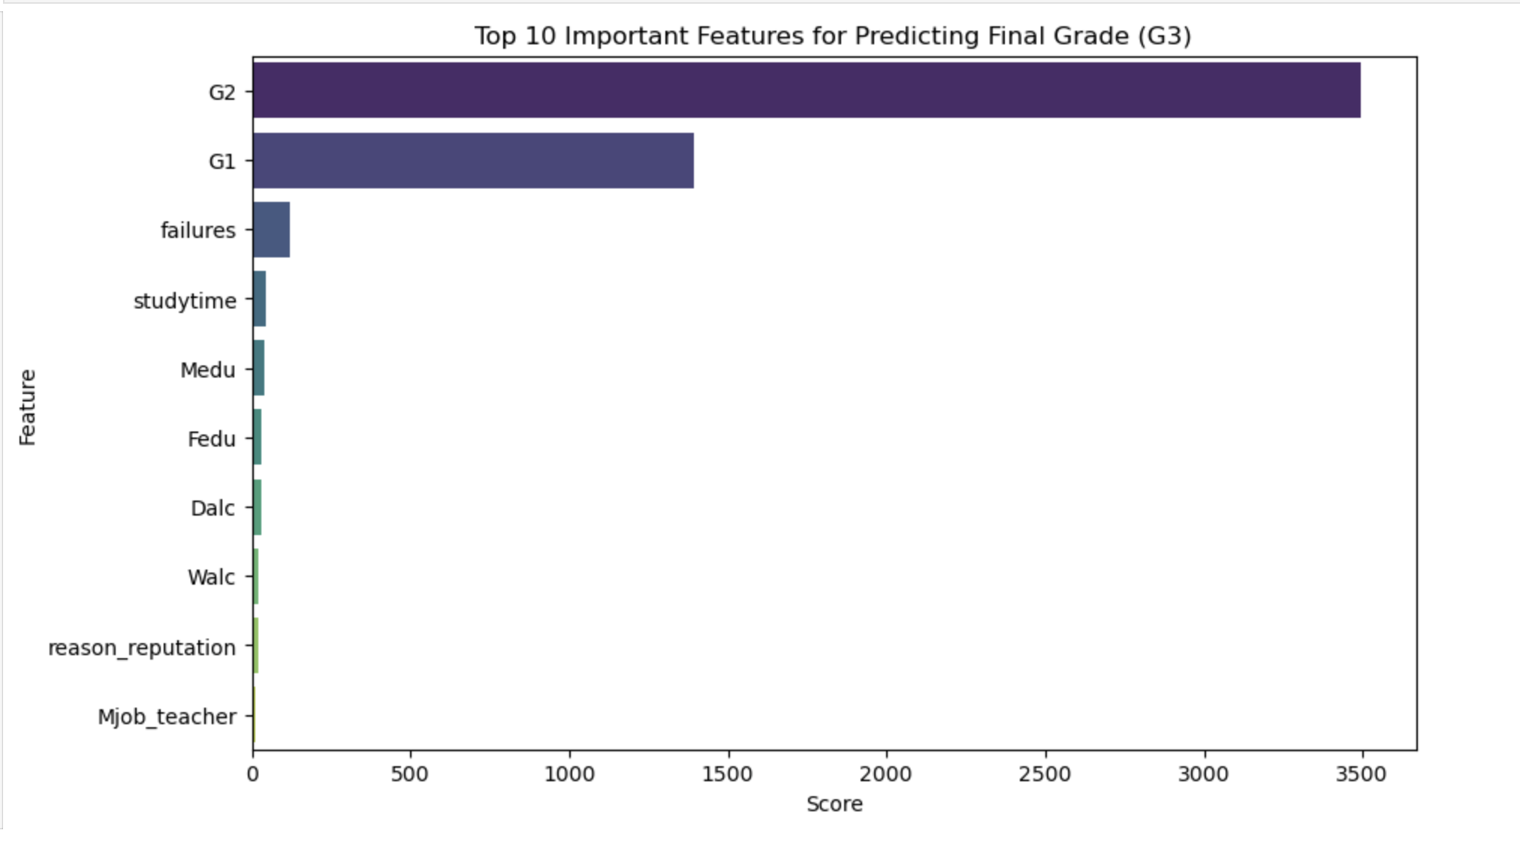
Feature Importance Analysis
This is where we utilized statistical scores to find which features (like G1, G2, studytime) are most useful in predicting the final grade
Created a barplot by utilzing Seaborn for a better view

Slide 11
Step 3 : Model Training and Performance Output
Split the data into training (80%) and testing (20%) sets
Trained 3 models: – Linear Regression → Mean Squared Error: 1.44, R² Score: 0.85 – Decision Tree —> Mean Squared Error : 3.97, R² Score: 0.59
– Random Forest —> Mean Squared Error : 1.62, R² Score:0.83
Measured performance using: – Mean Squared Error (MSE): How far off the predictions were – R² Score: How well the model explains the variation in final grades (G3)
Since linear regression had a R² Score value of 0.85, we can conclude that it was our best predictive model

Slide 12
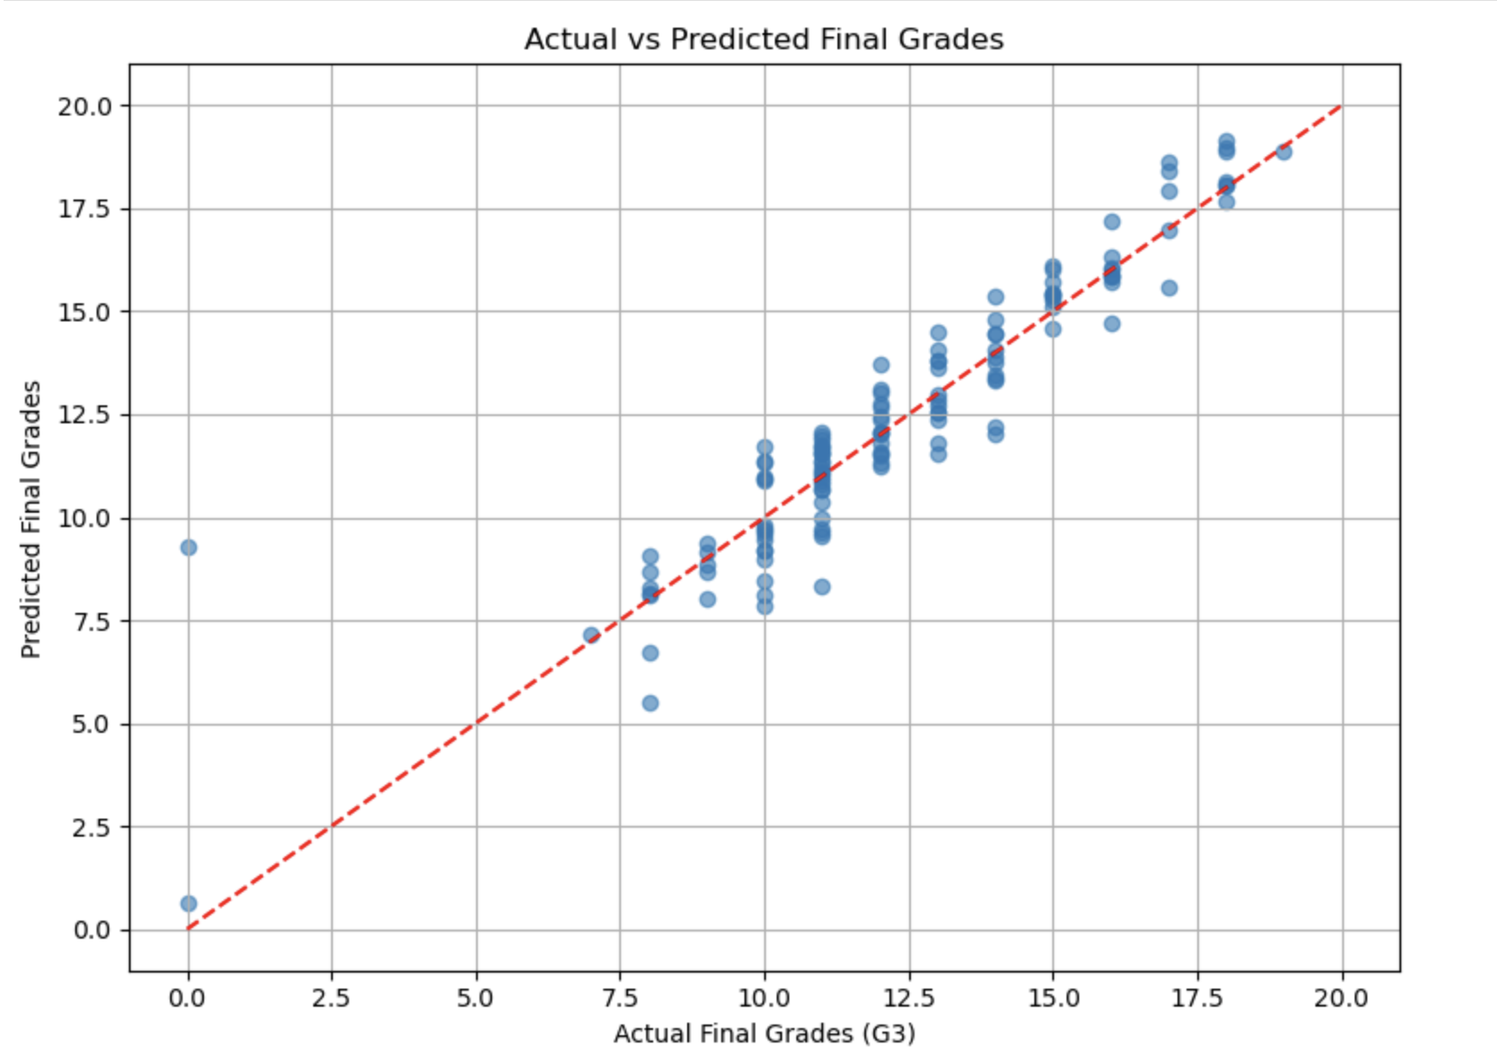
Step 4 : Visualizations of Model Performance
Scatter Plot: Actual vs. Predicted Grades

Slide 13
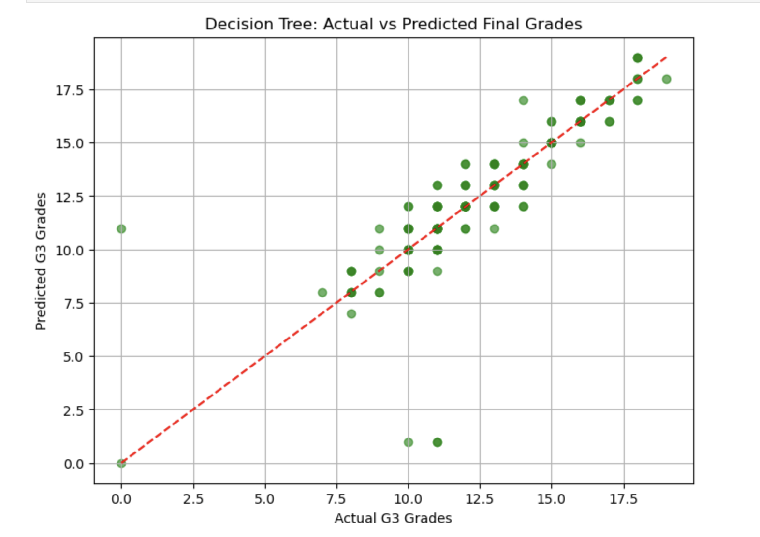
Decision Tree : Actual vs. Predicted Grades

Slide 14
Thank you!
Thank you!
Do you have any questions?

